Slide 1
Canada
Global Studies
Chapter 24

Slide 2
Provinces V. Territories
The provinces and territories of Canada combine to make up the worlds second largest country.
Ten provinces and three territories in all.
The major difference between a province and a territory is that provinces are jurisdictions that receive their power and authority directly from the Constitution Act, 1867, whereas territories derive their mandates and powers from the federal government.

Slide 3
10 Provinces, 3 Territories
Ten provinces are Alberta, British Columbia, Manitoba, New Brunswick, Newfoundland and Labrador, Nova Scotia, Ontario, Prince Edward Island, Quebec, and Saskatchewan
The three territories are Northwest Territories, Nunavut, and Yukon.

Slide 4
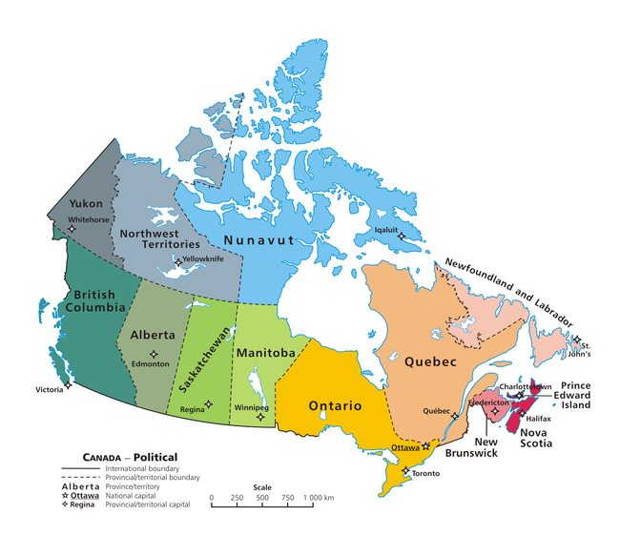

Slide 5
Government
Canada is governed as a parliamentary democracy and constitutional monarchy.

Slide 6
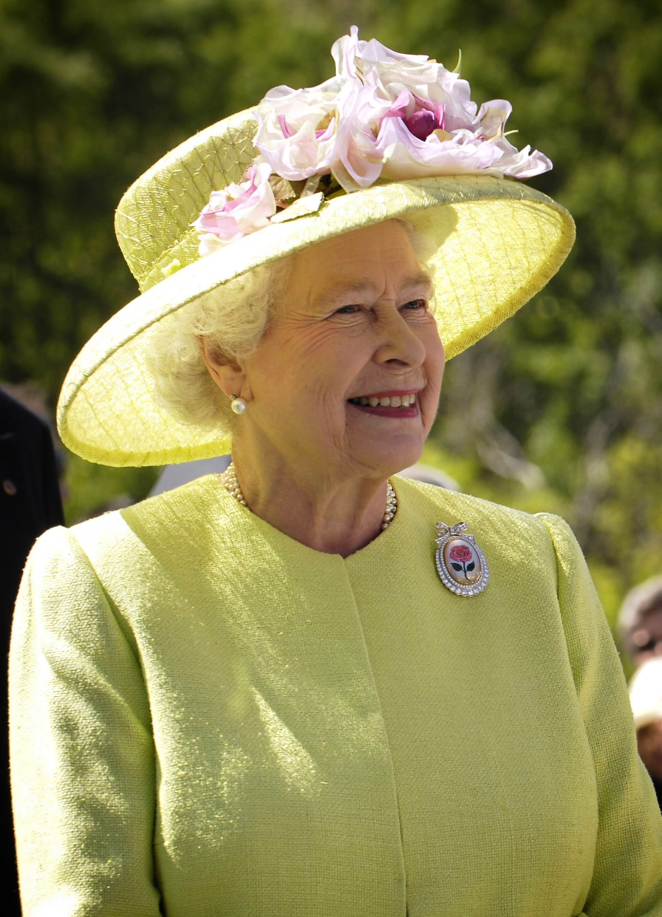
Long Live the Queen
The Crown today primarily functions as a guarantor of continuous and stable governance and a nonpartisan safeguard against the abuse of power.
Queen Elizabeth II

Slide 7
History
The land occupied by Canada was inhabited by various groups of Aboriginal groups.
Beginning in the late 15th century, British and French expeditions explored, and later settled, along the Atlantic coast.
Multiculturalism: Policy to preserve and maintain distinct cultural traditions.

Slide 8
Regions
Appalachian Region: Most eastern region of Canada. Lies between the Atlantic Ocean and the heavily forested Appalachian Mountains.
Great Lakes-St. Lawrence lowlands: To the north and west of the Atlantic Provinces. Fertile lowlands along the St. Lawrence River and the Great Lakes.
Canadian Shield: Covers almost half of Canada. Low hills, swamps, lakes poor soil. Splits the country in half. Provides mineral resources and wildlife.

Slide 9
Regions Cont.
Great Plains- Alberta and Saskatchewan to the Arctic Ocean. Rich soil. Breadbasket
Western Mountain region- Mountainous strip of land 500 miles wide “Rocky Mountains

