Slide 1
Hinduism and Buddhism
How are they Similar
And
How are they Different

Slide 2
Hinduism: Main Ideas
Started in India
No founder and no church
Not just a religion, but a social structure.
Intertwined with all aspects of life.
Embraced the caste system.

Slide 3
Hinduism:
CASTE SYSTEM
Indian society developed into a complex system based on class.
Castes are based on the idea that there are separate, different kinds of humans.
Higher-caste people considered themselves purer and closer to “moksha.”

Slide 4
Hinduism:
CASTE RULES
1. Higher castes would become spiritually unclean if they had contact with lower castes.
2. Must marry from your same caste.
3. Occupations had their own castes and these were determined at birth. (Brahmin became cooks because they were the highest caste)
4. Each caste had its own council that enforced caste rules.
5. The caste system was deeply imbedded in law, custom and religious tradition, and the lower-caste (untouchables) accepted the view of their own unworthiness.

Slide 5
Hinduism: Beliefs
Each (god) is part of a supreme force called Brahman.
Brahman is a “triad”– one god w/ 3 persons
Brahma = creator
Vishnu = preserver
Shiva = destroyer
Every person has an essential self, or
Atman.
Another name for the soul.

Slide 6
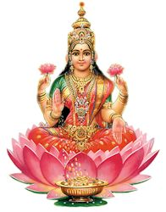
Brahma

Slide 7
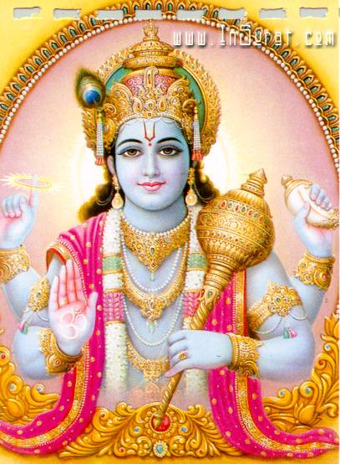
Vishnu

Slide 8
Modern Incarnation of Vishnu?

Slide 9
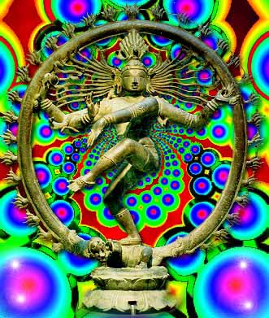
Shiva

Slide 10
Hinduism: Karma & Reincarnation
Karma: is the accumulated sum of ones good and bad deeds.
Determines how one will live in his/her next life.
Reincarnation: through pure acts one can be reborn at a higher level.
Bad deeds cause a person to be reborn at a lower level such as an animal.

Slide 11
Hinduism:
Each caste has its own dharma =
duties and obligations.
The way things are- the rules that run the universe.
Hope to improve caste position for the next life by following dharma.

Slide 12
Hinduism: The Caste System
Castes in decreasing order:
Brahmins = priests & academics
Kshatriyas = rulers & military
Vaishyas = farmers, landlords & merchants
Sudras = peasants, servants, and workers in non-polluting jobs
Dalits = untouchables

Slide 13
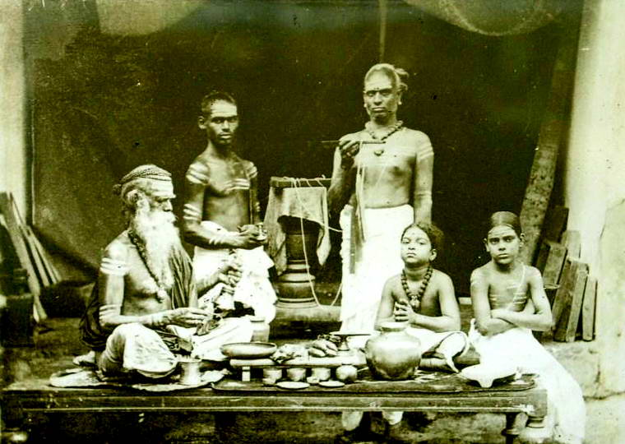
Brahmins at Prayer

Slide 14
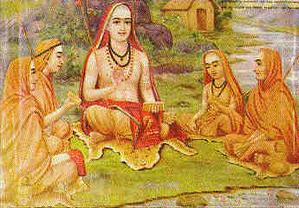
Brahmins Studying

Slide 15
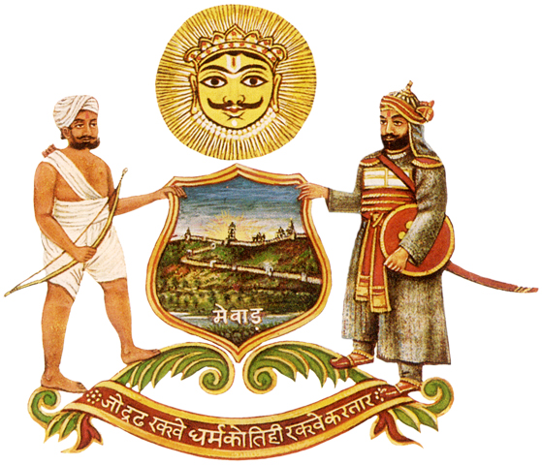
Kshatriyas

Slide 16
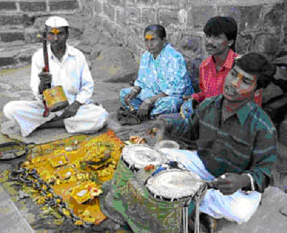
Vaishyas

Slide 17
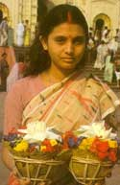
Sudras

Slide 18
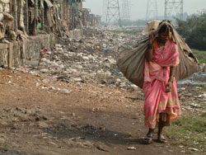
Dalit

Slide 19
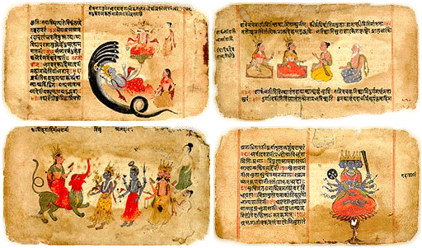
Hinduism: sacred texts Contain hymns and rituals
Upanishads
Vedas

Slide 20
Buddhism: Main Ideas
Started in Tibet and spread to China.
Gautama also known as Buddha or “Enlightened One.”
Do not have any gods.
Priests were/are not necessary.
Buddha was a teacher.
Rejected the caste system.

Slide 21
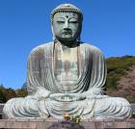
Buddha

Slide 22
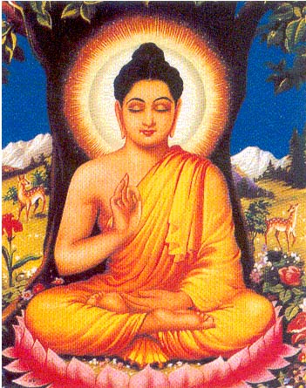

Slide 23
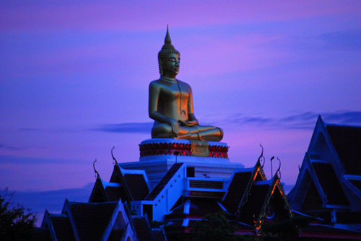

Slide 24
Buddhism: Gautama
Left his wife, child and luxurious lifestyle in order to seek truth.
He was determined to find a path to the state of Nirvana (a state of liberation and freedom from suffering).
A state of wanting nothing.

Slide 25
Buddhism: Attaining Enlightenment
One night (535 BC), while sitting under a ficus tree he experienced a major break- through.
Recalled all of his previous reincarnations
Saw how good and bad deeds lead to reincarnations
Learned that he had attained Nirvana and would never be reincarnated in a future life.
He had reached enlightenment!

Slide 26
Buddhism: Buddha’s teachings:
The Four Noble Truths: (what he learned under the tree)
Suffering is universal.
The cause of suffering is desire.
The only way to end suffering is to stop desire.
Achieving Nirvana: the condition of wanting nothing
The Eightfold Path leads to the end of desire.

Slide 27
Buddhism: Eightfold Path
Practical guide for right conduct.
Stressed understanding of the cause of suffering, compassion for all creatures, kindness, and truthfulness.

Slide 28
Buddhism: Eightfold Path
Understanding of the Four Noble Truths
Thinking: following the right path
Speech: no lying, criticism, gossip
Conduct
Livelihood: don’t harm others
Effort: good thoughts/ not evil thoughts
Become aware of your body, mind & feelings
Concentration: meditate

Slide 29
Similarities
Hinduism
Karma
Reincarnation
Salvation was achieved when one escaped the body.
Buddhism
Karma
Reincarnation
Salvation was achieved when one escaped the body.

Slide 30
Differences
Hinduism
No founder
Many gods
Had priests
Had caste system
Buddhism
Buddha (teacher)
No gods
Can seek Nirvana on your own
No caste system

